Slide 1
Task 1: Scan Your Local Network for Open Ports
Title : Open Ports on Internal Network Devices
Risk Rating : Medium (CVSS: 5.3) Risk may vary depending on the specific services running and how they are configured.
Summary : Several devices on the internal network were found to have open ports exposing services like HTTP, HTTPS, upnp, oracleas-https, http-proxy, https-alt, echo, discard, daytime, qotd, chargen, msrpc, netbios-ssn, microsoft-ds, msmq, zephyr-clt, eklogin, msmq-mgmt, wsdapi, realserver, and opsmessaging. If these services are misconfigured or outdated, they can become an entry point for attackers inside the network. This report outlines the services found, associated risks, and remediation steps.
Background : Port scanning is a key reconnaissance method used by attackers to map a network. Open ports can expose services such as file sharing, remote access, or web servers. If these are left unsecured, they can be exploited to gain unauthorized access or move laterally within the network. In this task, a TCP SYN scan was used via Nmap to discover devices and open ports on the local subnet. Tools like Wireshark were optionally used to analyze packet behavior during the scan.

Slide 2
Technical Details & Evidence :
Tools Used :
Nmap for port scanning.
Wireshark (optional) for packet inspection.
Network Range Scanned : 192.168.1.0/24
Commands Used :
nmap -sS 192.168.1.0/24
nmap -SV -p 80, 443, 1900, 7443, 8080, 8443 -T4 192.168.29.1
Nmap -sV -p 7,9,13, 17, 19, 80, 135, 139, 445, 1801, 2103, 2105, 2107, 5357, 7070, 8090 -T4 192. 168.29.172
Results Summary
IP Address | Open Ports | Detected Services
192.168.29.1 | 80,443, 1900, 7443, 8080, 8443 | http, ssl/http, upnp, ssl/oracleas-https, http-proxy, ssl/https-alt.
192.168.29.172 | 7,9,13,17, 19, 80, 135, 139,445, 1801, 2103, 2105, 2107, 5357, 7070, 8090 | Echo, discard, daytime, qotd, chargen, http, msrpc, netbios-ssn, microsoft-ds, msmq, zephyr-clt, eklogin, msmq-mgmt, wsdapi, realserver, opsmessaging.

Slide 3
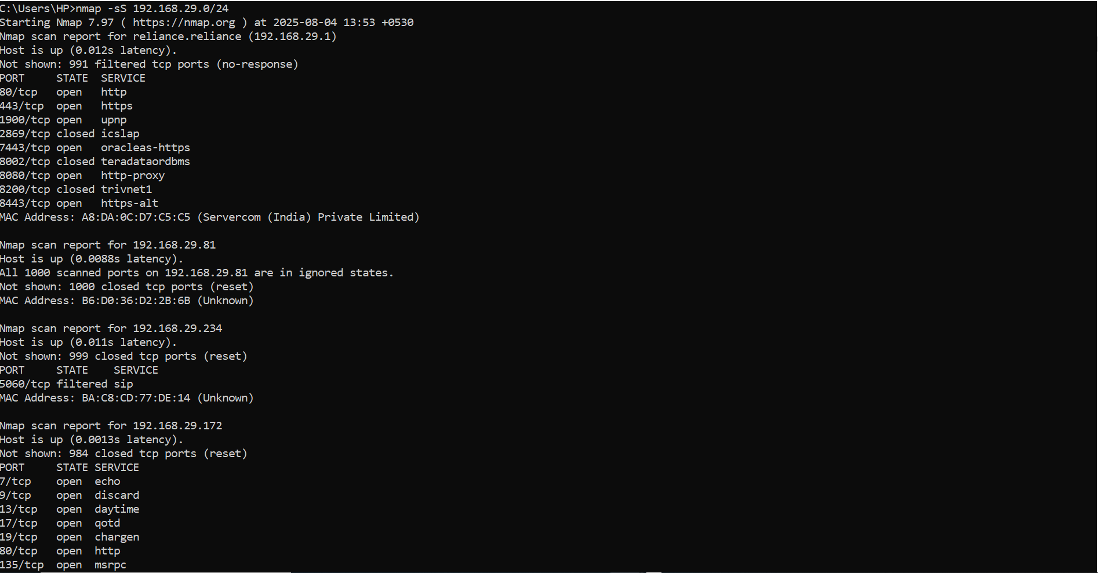
Nmap Images :
Image 1

Slide 4
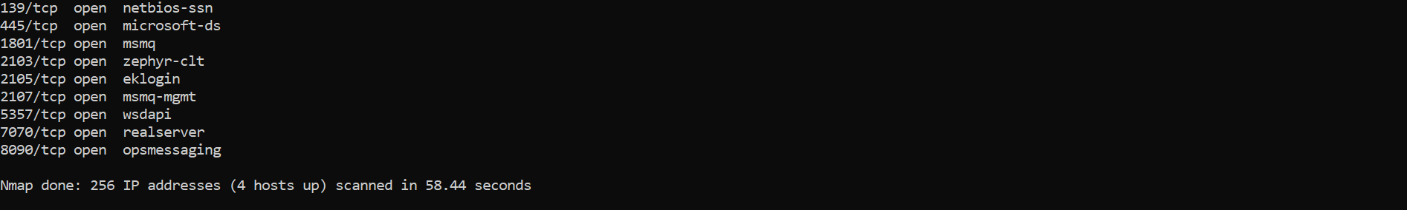
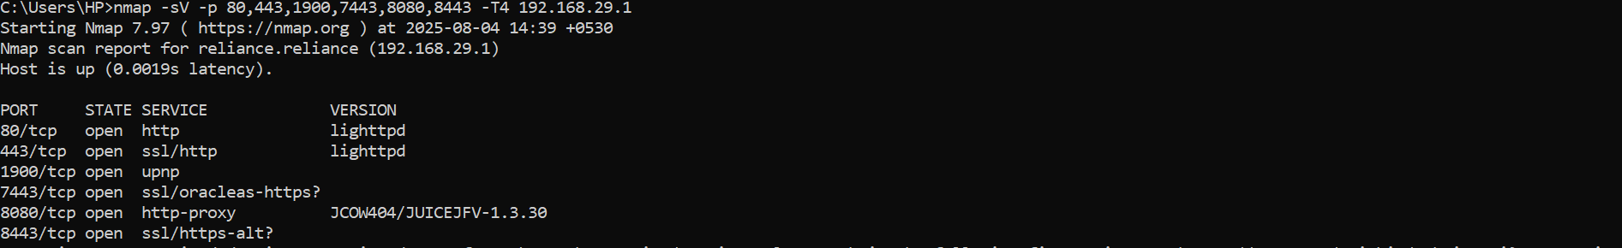
Image 2
Image 3

Slide 5
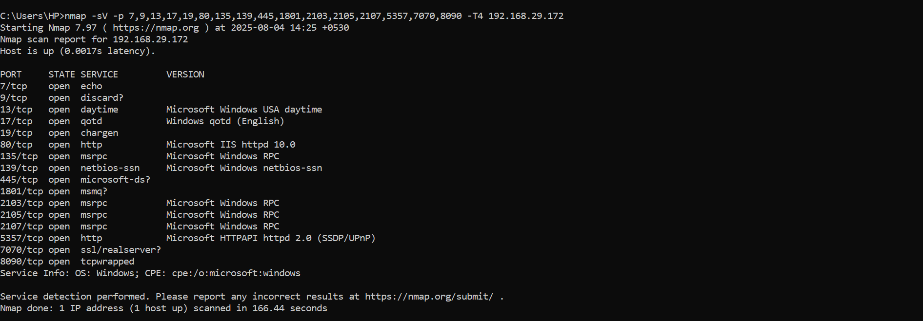
Image 4

Slide 6
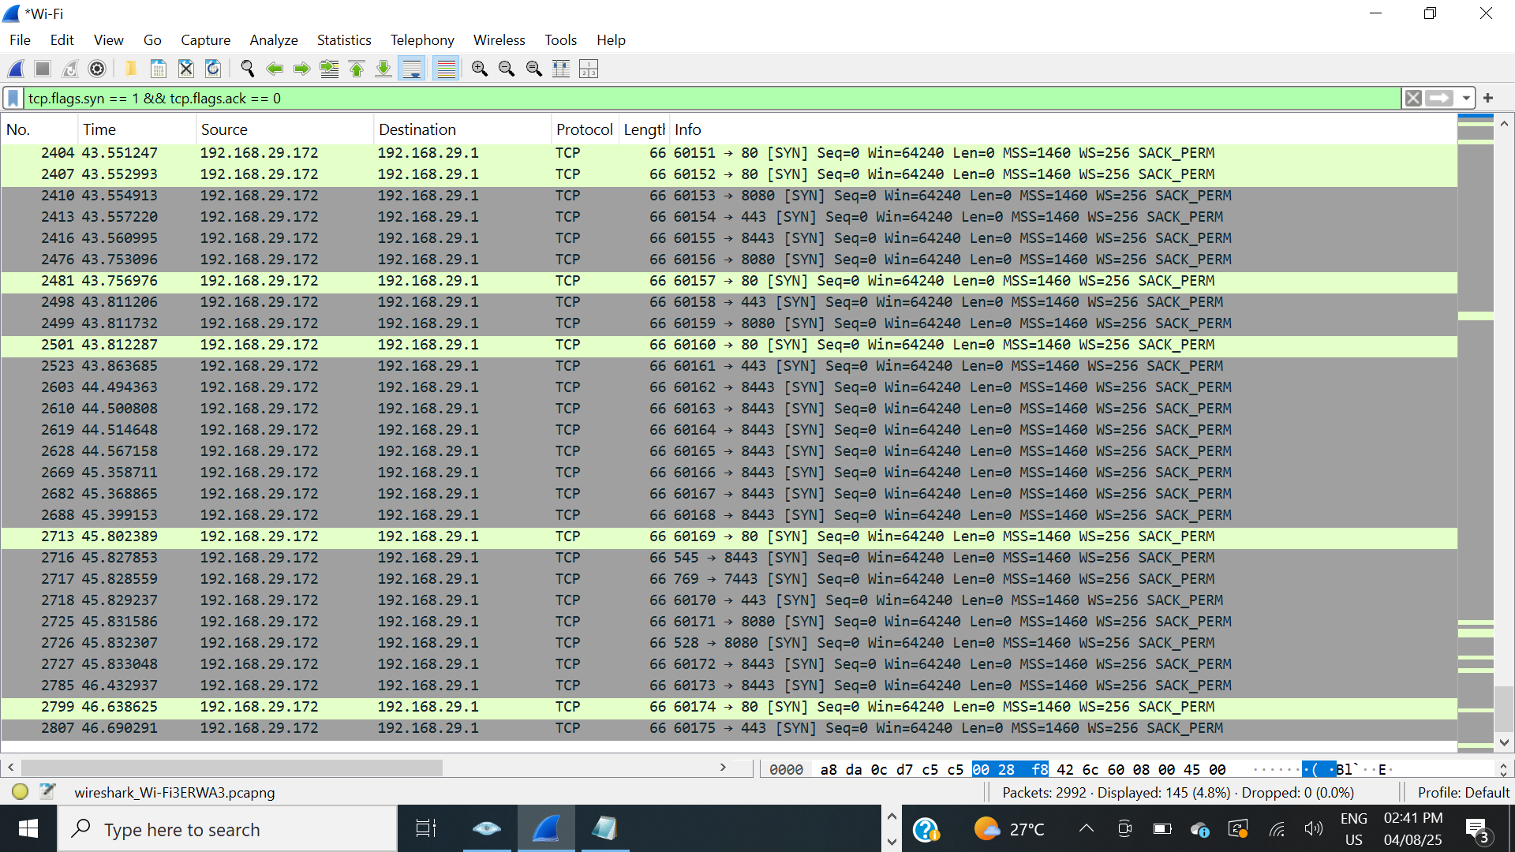
WireShark Images :
Image 1

Slide 7
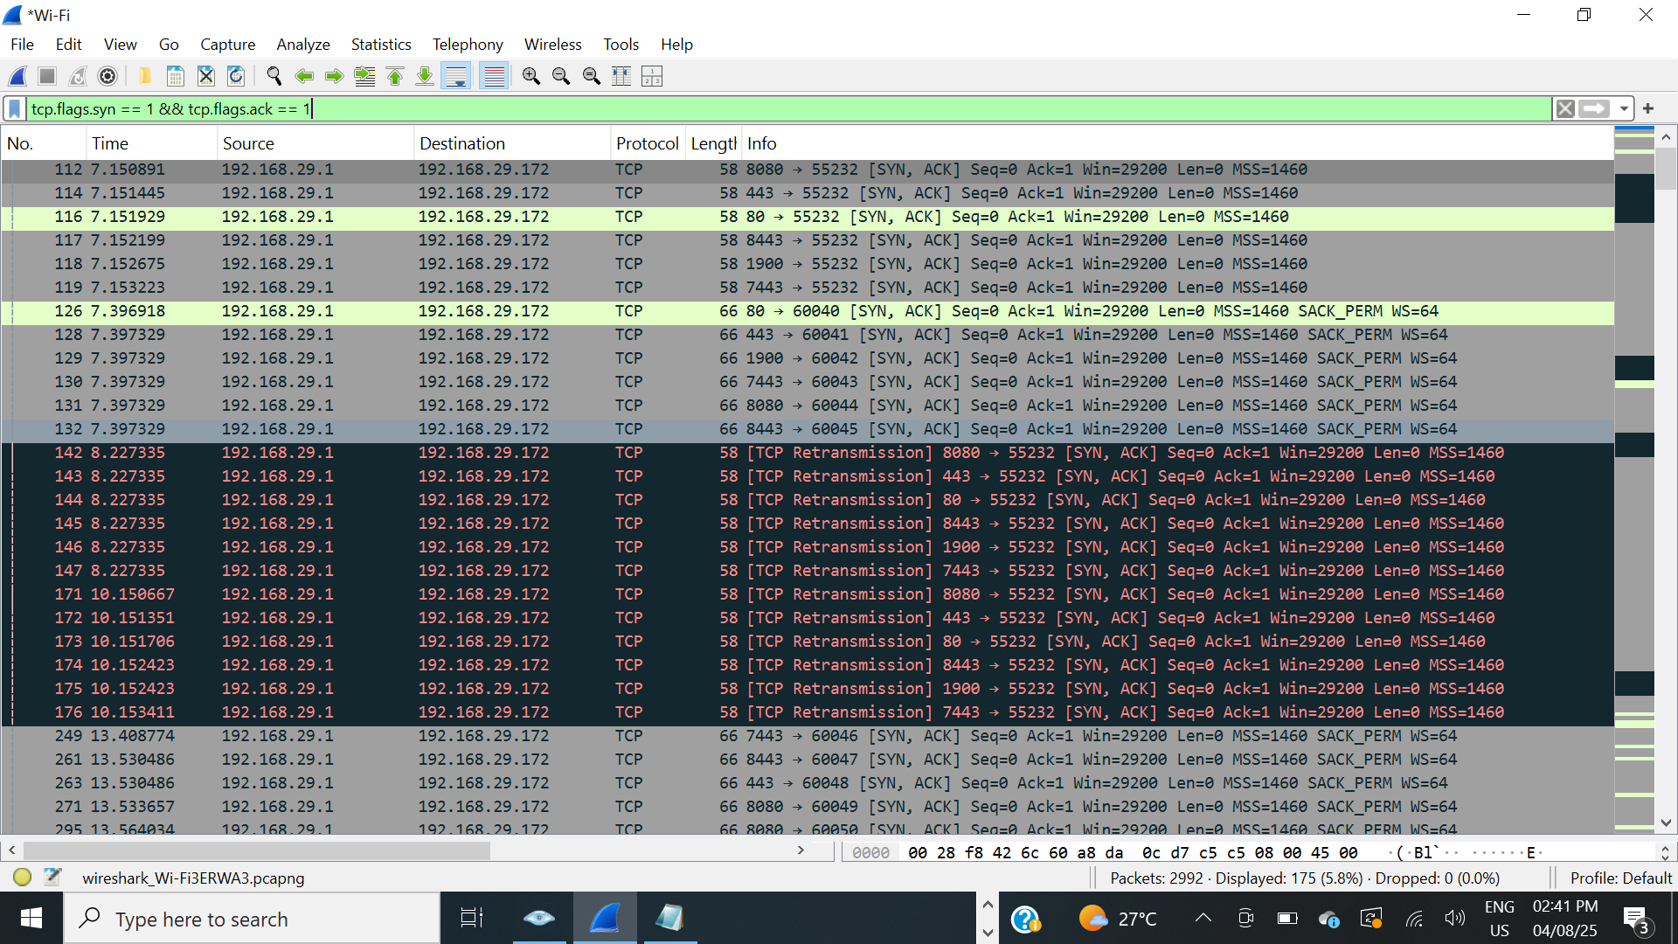
Image 2

Slide 8
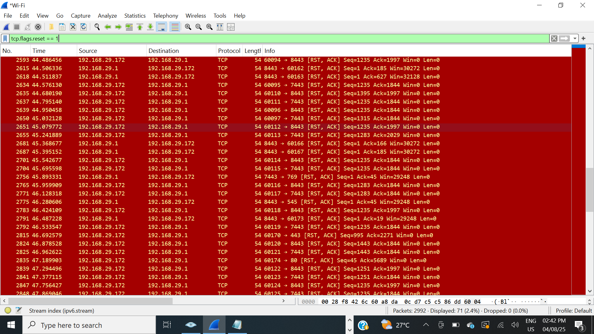
Image 3

Slide 9
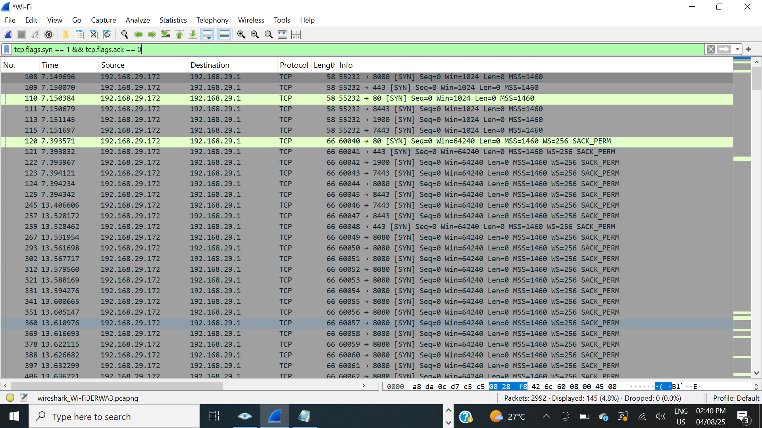
Image 4

Slide 10
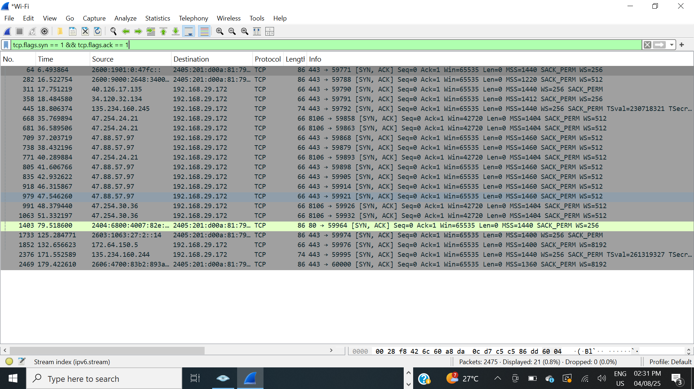
Image 5

Slide 11
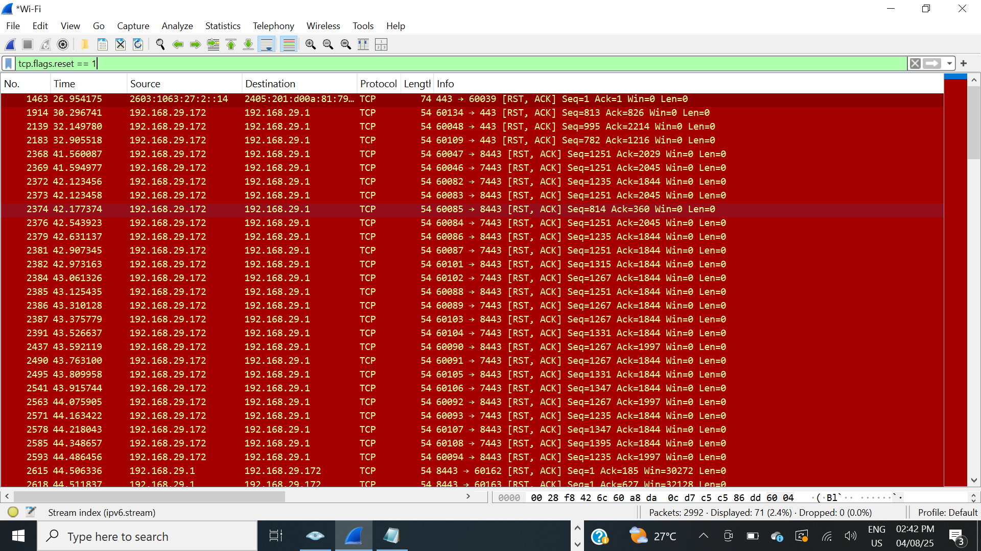
Image 6

Slide 12
Impact :
If these open ports expose outdated or misconfigured services:
Echo (7) Echo Service, somewhat outdated by ICMP echo. Port just echoes whatever is sent to it. This feature can be used in many attacks, such as Smurf/Fraggle.
Discard (9) Discard server - this protocol is only installed on machines for test purposes. The service listening at this port (both TCP and UDP) simply discards any input.
Daytime (13) Daytime service [RFC 867] - responds with the current time of day. Different machines respond with slightly different date/time format, so port can be used to fingerprint machines.
qotd (17) Rarely used today. Can be abused in UDP-based amplification DDoS attacks. Should be disabled unless used for a very specific internal purpose.
Chargen(19) Dangerous. Historically used for testing, now often abused in DDoS reflection/amplification attacks. Disable unless absolutely needed.
HTTP (80) Normal for web services, but check for outdated IIS versions, unpatched web apps, or default pages that leak info. Target for XSS, SQLi, etc.
MSRPC (135) Critical Windows service used for DCom, WMI, etc. Can be abused for remote code execution or lateral movement (e.g., with tools like Mimikatz or EternalBlue).
NetBIOS-SSN (139/tcp) may leak sensitive share names or credentials, and is often used in NTLM relay and credential harvesting attacks.
SMB (445/tcp) may be exploited by malware (e.g., WannaCry, NotPetya) to perform remote code execution or lateral movement.
MSMQ (1801/tcp) may allow unauthorized message injection or information disclosure if message authentication is not enforced.

Slide 13
MSRPC (2103/tcp, 2105/tcp, 2107/tcp) may expose Windows services to remote enumeration
or abuse if not properly secured.
HTTPAPI (5357/tcp) may reveal device capabilities or allow remote control via SSDP/UPnP, leading to potential misuse.
RealServer (7070/tcp) may be a legacy streaming service vulnerable to SSL downgrade or outdated protocol attacks.
Unknown Service (8090/tcp) may represent a custom or misconfigured application that could expose sensitive data or contain unknown vulnerabilities.
SSL/HTTP (443/tcp) may expose HTTPS applications to vulnerabilities such as SSL misconfiguration, weak ciphers, or outdated web apps.
UPnP (1900/tcp) may leak device information or allow remote control of services via SSDP, which can be abused for lateral movement or attacks.
OracleAS-HTTPS (7443/tcp) may expose Oracle-based services to SSL vulnerabilities or outdated web frameworks.
HTTP-Proxy (8080/tcp) may allow proxy abuse, internal SSRF, or proxy chaining if unauthenticated access is allowed.
HTTPS-Alt (8443/tcp) may expose admin panels or web interfaces over HTTPS that are often overlooked, making them attractive targets for attackers.
An internal attacker or malware already inside the network could use these ports to:
Gain unauthorized access.
Perform lateral movement.
Dump credentials or escalate privileges.

Slide 14
Remediation Advice :
Core Fixes:
Disable unnecessary services: Turn off services (like SMB, NetBIOS) on devices where they are not required.
Restrict access using internal firewalls (e.g., block port 445 except where needed).
Ensure services are updated to latest secure versions.
Enforce strong authentication (e.g., key-based login for SSH).
Defense-in-Depth :
Enable host-based firewalls (e.g., Windows Defender Firewall).
Use network segmentation (e.g., VLANs) to isolate sensitive devices.
Continuously monitor network activity and log suspicious connections.
References :
Nmap TCP SYN Scan Guide.
Microsoft SMB Security Best Practices.
OWASP Top 10: Network Exposure Risks.

